Slide 1


Business Plan for Money Lending Business In Sri Lanka Prepared by APAC team
14.10.2016

Slide 2
Table Of Contents
1 | Investment Summary | 3-5
2 | Market Overview | 6-10
3 | Legal Setup | 11-15
4 | Product & Business process | 16-21
5 | Digital Sales & Marketing | 22-26
6 | Decision making & Collection | 27-33
7 | IT | 34-38
8 | HR & Admin Information | 39-43
9 | Finance | 44-51
10 | Project Plan | 52-53
11 | Annexes | 54-67

Slide 3
Investment Summary

Slide 4
Investment Summary
Sri Lankan consumer lending market creates excellent opportunities for digitally advanced new comers because:
GDP per capita twice an average GDP in South Asia and keep growing.
After 26-year civil war (1983-2009), that caused significant hard-ship for the population, environment and the economy of the country, Sri Lanka entered an era of healing and peace building, continued by drastic development of the nation well-being.
Few lenders offer loans without collateral. Predominantly upper segment might be able to get personal loans since these people possess a required collateral.
Smartphone penetration demonstrates aggressive growth due to affordable prices for electronic devices.
The Government actively promotes the increased adoption of Information and communication technology (ICT) services:
a free internet access was provided at public places.
e-Government* project was initiated to facilitate governmental services
an agreement with Google Inc. was signed to initiate the ‘Google Loon project’ (Google’s balloon-powered high-speed internet service)**
Business-oriented government creates a favourable environment for foreign investments – in June 2016 prohibition relating to non-residents acquiring shares in a company carrying the business of money lending has been removed .
Key success factors:
Simple legal setup since license is not required for money lending as long as deposits are not taken. After entering the market we will consider and possibly select other types licensing
Pure online is possible:
E-signing is recognized and e-contracts are fully enforceable in Sri Lanka (physical signing is not required, no face-to-face communications)
High banks account penetration and strict KYC regulation provided
Smartphone penetration is growing, PCs and laptops are widespread among population, the entire island is covered with 4G internet
Market is ready: having modern electronic items, Sri Lankans demand qualitative digital services, while competitors offer off-line services.
Easy way to deliver and collect money due to well developed and affordable money remittance between bank accounts. Payment systems are available for repayment.
There are no restrictions upon digital advertisement of money lending business
Source: * http://www.cbsl.gov.lk//pics_n_docs/10_pub/_docs/efr/annual_report/ar2015/english/7_Chapter_03.pdf
** https://www.theguardian.com/technology/2016/feb/16/project-loon-google-balloon-that-beams-down-internet-reaches-sri-lanka

Slide 5
Investment Summary
Investments, thsd USD | Year 1 | Year 2 | Year 3 | Year 4 | Year 5 | Total
Portfolio investments | 1 295 | 1 430 | 126 | 0 | 0 | 2 851
OPEX and CAPEX investments | 1 148 | 161 | 0 | 0 | 0 | 1 309
Total investments | 2 444 | 1 591 | 126 | 0 | 0 | 4 161
Volume indicators | Year 1 | Year 2 | Year 3 | Year 4 | Year 5 | Total
Number of loans issued, thsd | 32 | 158 | 264 | 362 | 422 | 1 238
Amount disbursed, thsd USD | 3 088 | 15 408 | 25 527 | 34 957 | 40 642 | 119 622
Net portfolio (EoY), thsd USD | 789 | 2 054 | 3 163 | 4 146 | 4 410 | 14 561
P&L, thsd USD | Year 1 | Year 2 | Year 3 | Year 4 | Year 5 | Total
Revenue | 810 | 5 328 | 9 502 | 13 431 | 16 034 | 45 105
Provisions | -659 | -2 931 | -4 479 | -5 540 | -6 472 | -20 081
Variable costs | -563 | -1 407 | -2 256 | -3 096 | -3 606 | -10 929
Marketing acquisition costs | -385 | -527 | -815 | -1 087 | -1 206 | -4 020
Salary (variable part) | -127 | -388 | -516 | -680 | -796 | -2 506
Other variable costs | -20 | -69 | -96 | -128 | -148 | -462
VAT | -32 | -424 | -829 | -1 200 | -1 456 | -3 941
Fixed costs | -1 016 | -1 125 | -1 036 | -1 141 | -1 171 | -5 490
Salary (fixed part) | -709 | -807 | -726 | -826 | -886 | -3 954
Other G&A expenses | -307 | -318 | -310 | -315 | -286 | -1 536
One-off expenses | -49 | -15 | -15 | -15 | -15 | -109
Net profit before taxes | -1 476 | -151 | 1 715 | 3 639 | 4 769 | 8 496
Terminal value |  |  |  |  |  | 20 968
ROE (annualized) |  |  |  |  |  | 60%
ROAA (yearly) | -187% | -11% | 64% | 72% | 80% | 51%
Break-even period – 17 months
Self-capitalization period – 26 months
Payback period – 56 months
Total investments from – $4,2M
Unoptimized Yr5 corporate tax – $1,3M
Terminal Value – $21,0M (Gordon growth model with discount factor 15% and growth rate 0%)

Slide 6
2. Market Overview

Slide 7
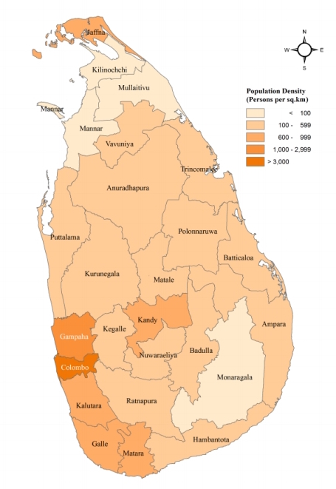
General Market Information
№ | Parameterer | Sri Lanka | Colombo
1 | Population (mln) | 21 | 2,63
2 | Labor force ratio | 42% | 49%
3 | Unemployment rate* | 5,3% | -
4 | GDP per capita** | $3.9K | -
5 | GDP growth (5Y average) | 6,0% | -
6 | Average Monthly income**** | $233 | $363
7 | Mobile phone penetration (inc. smartphones)*** | 116% | -
8 | Smartphone penetration (out of mobile), forecast 2016 | 41% | 60%
9 | Internet users penetration (inc. mob. broad band) as of 2015 | 27%
10 | Facebook accounts penetration***** (out of total population), as of 2016 | 21% | 95%
11 | Bank accounts penetration** (out of total population), as of 2015 | 83% | -
12 | ATMs per 100 000 adults**, as of 2014 | 17 | -
13 | Bank branches per 100 000 adults**, as of 2014 | 19 | -
14 | Debit card penetration (out of total population) | 48% | -
15 | Credit card penetration (out of labor force) | 13% | -
16 | Online banking penetration | 11% | 47%
Official languages:
Sinhala, Tamil & English
Most populous cities:
Colombo – 2,63 mln Kandy – 1,40 mln
Gampaha – 2,34 mln Galle - 1,08 mln
Kalutara – 1,64 mln Matara – 0,82 mln
* source of information - http://erd.cbsl.gov.lk/presentation/htm/english/erd/sdds/rpt_sdds.aspx
** source of information - [World Bank, World Development Indicators]
*** source of information - http://www.cbsl.gov.lk/pics_n_docs/10_pub/_docs/efr/annual_report/AR2015/English/7_Chapter_03.pdf
**** Household income and expenditure survey (Ministry of Finance and Planning)
***** Facebook Audience Insights

Slide 8
Consumer Finance Industry Landscape
First formal financial institutions were established in 1828 under the British rule in order to facilitate the needs of the plantation sector.
Other sectors of economy were catered by informal lenders. Indian born money lenders emerged to finance the needs of local people in trade and consumption.
Pawn brokerage became the common method of consumer lending. Special laws were enacted to protect pawned article owners and to implement anti usury policies.
The opening up of the economy in 1977 paved the way for financial institutions to expand and develop new products to cater to the growing needs.
Nowadays the formal financial sector in Sri Lanka consists of:
25 Banks (19 domestic and 6 foreign)
46 Licensed financial companies (LFCs)
220 registered pawnshops
2000+ microfinance and money lending companies.
The access to credit from Banks and LFCs in Sri Lanka is limited due to strict credit policies. Licensed microfinance companies are supposed to provide financial accommodation to low income persons and microenterprises. Therefore more than 2000 unlicensed money lending companies + informal money lenders (Poli Mudalali) offer financial accommodation to middle income customers who are able to secure their personal loans.
While banks’ portfolios contain a portion of unsecured loans disbursed to wealthy and high quality borrowers, unlicensed money lending companies and informal lenders do always ask for security in form of collateral, guarantors or personal bonds (Promissory Notes/Post Dated CHEQUES).
In general only upper segment is eligible for bank loans. Middle class, if does not possess sufficient security, ask guarantors’ support predominantly in case of emergency. There is no financial accommodation to satisfy everyday needs and facilitate consumption.

Slide 9
Consumer finance market size estimation
Estimated Sales of short term loans (in mln USD) and our market share
Banks & LFCs, mln USD
CAGR = 12,5%
MFIs, MLs, Pawnshops, and Informal lenders, mln USD
mln USD
Our market share, %
 | 2017 | 2018 | 2019 | 2020 | 2021
Our disbursement volumes (mln USD) | 3,1 | 15,4 | 25,5 | 35,0 | 40,6
Our Number of loans disbursed per year ‘000 | 32 | 158 | 264 | 362 | 422
Main assumptions:
Market demonstrates a moderate growth from 10% to 15% depending on type of business activity. We expect that unsecured lending market will demonstrate the max. growth up to 15%.
New volumes of licensed money lenders are relatively low with comparison to new volumes of unlicensed money lenders.
Money lending market is a growing market and people need cash to fulfill day to day needs and services .
Sources: CBSL reports, www.microfinance.lk, CRIB, Interviews, IFC country report

Slide 10
Licensing Options
Parameters | Bank | Licensed Finance Company (LFC) | Finance leasing Company (FLC) | Pawnshop | Micro Finance company | Money Lending company
Main purpose | Full-range of banking services for retail and corporate clients | Lending services and deposits taking | Financial leasing | Lending services with collateral | Lending services and deposits taking (limited by Monetary Board) | Lending services
Minimum paid-up capitalization | $34.48 Mln | $2.75 Mln | $2.1 Mln | Unspecified | Depends on Monetary Board decision | Unspecified
Max foreign capital share | Depends on Central Bank decision | Depends on Central Bank decision | Depends on Central Bank decision | Restricted | Up to 100% | 100%
Interest cap | 24% | No interest cap, Charges cap - max 5% of principal amount | No interest cap, Charges cap - max 5% of principal amount | 24% | Depends on Monetary Board directions (no such directions have been made as of date) | NO
Regulator | Central Bank Of Sri Lanka/ Financial Intelligence Unit | Central Bank Of Sri Lanka/ Financial Intelligence Unit | Central Bank Of Sri Lanka/ Non-Financial Intelligence Unit | Provincial Councils (Government Agent)/Police | Central Bank of Sri Lanka/ Monetary board/ Micro Finance Institution Unit | Not specified
Term for getting license/Registration | No new license available | No new license available | Subject to Central Bank decision | Up to 1 Month | 1 – 3 Months | Up to 1,5 months (just company registration)
Number of active licenses | 25 | 46 | 7 | 220 registered | No license has been issued as of date | License is not required 2000+ companies
It is possible for foreign company to incorporate a subsidiary company in Sri Lanka to carry out the money lending business without licensing (according to F.J.&G. De Saram). Since money lending market is getting mature and more regulated, it is worth to consider which license will be the most appropriate for our business model in the future. According to our international experience a pawnshop licence is more accessible than others, however we are considering other options as well.
Source: www.cbsl.gov.lk / http://www.microfinance.lk/ / http://www.commonlii.org/lk/legis/consol_act/pb99195.pdf /

Slide 11
3. Legal Setup

Slide 12
Regulation
 | Money lending company | Microfinance company | Pawnshop
Regulator | No | Monetary Board of the Central Bank of Sri Lanka | Government Agents (provincial councils or administrative heads of public services in the particular district)
Document regulating Money lending | Money lending ordinance (08/1918, last amendment in 1963) | Money lending ordinance (08/1918, last amendment in 1963) Microfinance act (12/2015) | Money lending ordinance (08/1918, last amendment in 1963) Pawnbroker’s ordinance (04/1942, last amendment in 1973)
Mandatory documents for Money lender | No | Microfinance license | Pawnbroker’s license
Associated risks | Possible pressure from the Government (incl. CBSL) on a company or banks which held company’s accounts for encouraging company to get a license. | The Monetary Board has been given extensive powers under the Microfinance Act to issue directions as to the manner in which any aspect of business of a microfinance company are to be conducted. Even if there is no certain direction as of date, it may occur case-by-case or for entire microfinance segment. | Current legislation prohibits foreign companies from doing pawning business in Sri Lanka. Therefore related business to be carried out via nominal company, that needs to be properly coordinated
Risk mitigation | Consider an appropriate license for obtaining | Money lending business should be carried out via Money Lender (subject to regulation) and Lead Generator | Utilize a set of documents that restrict nominee power
Additional regulations:
International transactions are regulated by the Controller of Exchange of the Central Bank of Sri Lanka under Exchange Control Act
Electronic transaction Act (05/2006) facilitates the formation of electronic documents and other communications in electronic forms
We are launching money lending business without licensing (as long as deposits are not taken). After entering the market we will consider and possibly select other types licensing.

Slide 13



Critical Business Model parameters
# | Parameters | Money lending company | V
1 | New licenses | No necessity for obtaining a license for money lending as long as company is not accepting deposits (according legal opinion of FJ&G de Saram)
2 | Foreign Capital | 100% by non-resident investor
3 | Allowed credit products | No restrictions
4 | APR/EIR interest cap | Not Specifically Stated
5 | Late payment | No restrictions
6 | Advertising requirements | no rules or restrictions
7 | Remote contract signing | A contract is not denied legal validity or enforceability on the sole ground that it is in electronic form and it is authenticated by means of an electronic signature.
8 | Face-to-face customer’s verification (KYC procedure) | No rules or regulations for Money Lending company (KYC provided by Bank)
9 | Access to credit bureau | No legal access, but we are building a partnership with lending institution to obtain credit reports available
10 | Debt collection | No specific restrictions
11 | Possibility to use and store clients data out of the country | Yes, we can use and store clients data out out of the country
12 | Necessity to obtain written customer consent for processing his personal data | It is advisable to obtain the written consent of the customer prior to processing his/her personal data even though there is no legal requirement to do so.
13 | The funding of the loan portfolio | Top-up paid up capital via inward remittance from abroad to shareholder’s Securities Investment Account(SIA). Loans to residents can be granted under a special permission of the Controller of Exchange.
14 | Money transfer from abroad | Dividends, proceeds on sale, liquidation, capital redemption or share buy back. Recovery of principal and interest is possible only for loans extended under a special permission granted by the Controller of Exchange.
No specific issues
Need to pay some attention, but no serious issues
There are some issues, which require serious attention.

Slide 14
Legal setup: Structure
SG
Equity participation
Link
Paid-up capital
APV
MM
100%
Paid-up capital = min $1
(up to required portfolio amount)
100%
min $1
(up to OPEX required)
LK
Digital money lender
service contract
Lead Generating Company
Service
agreement
Loan agreement
Borrowers
Loan repayment
We are launching money lending business without licensing (as long as deposits are not taken). After entering the market we will consider and possibly select other types licensing.

Slide 15
Long term licensing options
As soon as our business volumes become considerable and the market itself become mature, the Central Bank might encourage us to obtain a license. Anticipating possible intention, we are considering several ways of getting an appropriate license. Currently we are investigating a pawnbroker's license and microfinance license whose main features are represented below.
Pawnbroker's license
Parameter | Current regulation | Comment
New licenses | Available for local private company. Term of getting a license is 1 month. | Following to our experience Pawnshop can be carried out via nominal company, that needs to be properly coordinated.
Foreign Capital | Restricted | Power of nominee is restricted through a set of agreements*
Allowed credit products | Personal loan secured by collateral | Mobile phone can be used as a collateral. Special agreement of safe keeping the collateral will be signed with customer
Interest rate cap | 24% per annum | Service fee will be charged by LGC
Microfinance license
Parameter | Current regulation | Comment
New licenses | Available for local public company. Term for getting a license is up to 3 months. | CBSL gives a priority to register the existing MF companies who were carried out microfinance business.
Foreign Capital | 100% by non-resident investor | This gives us an opportunity to incorporate a local subsidiary that will 100% belong to foreign investor
Allowed credit products | Lending services and deposits taking | The Monetary board may issue directions to stipulate the terms and conditions under which any loan may be granted. No such directions have been made as of date.
Interest rate cap | No interest cap as of date | The Monetary board may issue directions to stipulate the maximum rate of interests and fees which may be charged on loans.
* - Master agreement on business cooperation, Capital contribution assignment agreement, equity interest mortgage agreement, Guaranty agreement

Slide 16

4. Product & Business process

Slide 17
Consumer Lending Landscape
# | Parameter | Informal Lenders (private individuals) | Money lending company | Microfinance company* | Pawnshops | Banks & LFCs
1 | Loan amount | $250 – $10 000 | $200- $3000 | $200- $1000 | $50 - $1000 | Up to $50 000
2 | Average loan | $1000 | $1000 | $700 | $300 | $3 000
3 | Loan tenure | 1 day - 1 month | Up to 60 months | 12 months | 9 months | 12-60 months
4 | Service fees | 5% | 5% | 2% | - | 2%
5 | Interest rate, per annum | 120%-240% | 180% | 25%-40% | 24%-36% | up to 24%
6 | Effective IR per annum | up to 380% | up to 240% | up to 90% | up to 36% | Up to 30%
7 | Late fee | no | 25$-75$ per week | 25$-75$ per week | no | 3% p.a.
8 | Time to money | 1 day - 3 days | 1 day - 3 days | 1 day - 3 days | 30 minutes | Up to 21 days
9 | Loan disbursal | Cash or Cheque | Cash in Office, Bank transfer | Cash in Office, Bank transfer | Cash in office | Cash in branch or to an account
10 | Verification | ID, Salary proof, Address proof, Field visit | ID, Salary proof, Address proof, phone verification. | ID, Salary proof, Address proof, phone verification | ID, Collateral valuation | ID, Salary proof, Address proof, Credit Bureau check, Phone verification
11 | Target Customers | Customers without official work or in an urgent need of money. | All types of clients who can provide sufficient collateral or guarantors | Official employees and entrepreneurs, rural self employed people who can provide guarantor. | All types of clients who can provide collator (Gold Items). | Only for customers that have good to strong credit history
12 | Business model | Offline | Offline | Offline | Offline | Offline
* For the purposes of comparison, in this table Microfinance company is an entity that provides financial accommodation to low income persons and microenterprises, even though it may provide a variety of financial services.

Slide 18
Our product offer
# | Parameter | Our Offer
1 | Loan amount range | max $110 in Colombo and max $70 in other Districts (loan amount < 30% of monthly Income)
2 | Average loan size | $80
3 | Tenor range | 7, 15, 21, 30 days
4 | Average tenure | 25 days
5 | Interest rate | 18,25 % per annum (0,05% per day)
6 | Service fee | from 8% to 32% of loan amount depending on tenure
7 | Upfront/handlig fees | 0%
8 | Effective IR rate per annum | 405% p.a. = 1,11% per day = 0,05% (IR) + 1,06% (Service fee)
9 | Overdue interest rate | 1,5% per day
10 | Late payment fee | $ 10 (Rs 1 500)
11 | Prolongation fee | 0%
12 | Early loan repayment feature | No earlier than after passing 7 calendar days
13 | Time to money | 30 minutes – 1 day
14 | Loan disbursal | Bank transfer
15 | Business model | Pure online
Loan amount range
Rs 15 000 | $ 110 | Colombo
Rs 12 500 | $ 90 | Colombo
Rs 10 000 | $ 70 | Sri Lanka
Rs 7 500 | $ 55 | Sri Lanka
Rs 5 000 | $ 35 | Sri Lanka
Tenure | Service fee
7 days | 8%
15 days | 16%
21 days | 23%
30 days | 32%
We are offering single payment loan with certain range of loan amounts, tenures, and service fees. Interest rate is competitive. Customer allowed to do early repayments after passing 7 days.

Slide 19






Initial Sales Business Process
Application
Decision
Loan disbursement
Terrasoft
9. Credit policy compliance/ Scoring
10. Phone verification (get additional data)
11. Automatically generates a list of approved customers
8. Internal Black list check
7. Deduplication
12. Welcome call/ verification of customer accessibility
***
Payment agent
13. Automatically generates Loan agreement
16. Send the list to Payment Agent
17. Upload the list to its payments system
Customer
Web site
Filling online app via:
Website or
Mobile app or
Inbound call
2. Stop factors check
6. External data gaining
14. Send to customer the electronic Loan Agreement
15. Generate transaction details list
18. Automatically transfer money to customers’ accounts
3. Generates SMS verification code
5. SMS code check
$
20. Perform accounting procedures
**
4. Customer puts SMS code in appropriate field
19. Bank identifies customer via his ID.
Customer collects cash
*
Already implemented integrations
New integrations to be implemented in Terrasoft
Logical step in the business process
Money transfer
* SMS gateway provider: TextWare (Private) Limited
** GL system provider: Scienter Technologies
*** Payment Agents: Sampath Bank (Sampath wishva Corporate), Pass accounting solution

Slide 20
Repeat Sales Business Process
Application
Decision
Loan disbursement
Terrasoft
9. Credit policy compliance/ Scoring
10. Automatically generates Loan agreement
8. Internal Black list check
7. Deduplication
***
Payment agent
13. Send the list to Payment Agent
14. Upload the list to its payments system
Customer
Web site
Filling online app via:
Website or
Mobile app or
Inbound call
2. Stop factors check
6. External data gaining
11. Send to customer the electronic Loan Agreement
12. Generate transaction details list
15. Automatically transfer money to customers’ accounts
3. Generates SMS verification code
5. SMS code check
$
17. Perform accounting procedures
**
4. Customer puts SMS code in appropriate field
16. Bank identifies customer via his ID.
Customer collects cash
*
Already implemented integrations
New integrations to be implemented in Terrasoft
Logical step in the business process
Money transfer
* SMS gateway provider: TextWare (Private) Limited
** GL system provider: Scienter Technologies
*** Payment Agents: Sampath Bank (Sampath wishva Corporate), Pass accounting solution

Slide 21
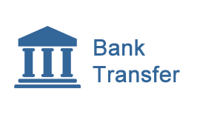






Repayment channels
Easy to get an access
Hard to get an access
Both retail chains currently accept payments from individuals
High penetration of bank accounts (83% out of total population), and widespread bank branch network
The largest retail chain in the island comprising over 266 outlets including, Cargills Food City supermarkets and Cargills Express convenience stores.
More popular
(3329 branches) make bank transfers possible in Sri Lanka.
Sri Lanka Interbank Payment System (SLIPS) permitting same-day settlement among all account-to-account transfers.
Keells Super is the supermarket chain which consists of 57 outlets primarily in largely populous districts.
High penetration of Debit cards (48% out of total population) allows us to utilize Payment gateway facility. Access can be provided by local Bank directly (Sampath is a leader) or via specialized payment platform such as BizPay.
ezCash enables people to perform financial transactions using their Dialog, Etisalat, and Hutch mobile phone. Maximum limit per payment transaction per day Rs 10 000 (Classic account), Rs 25 000 (Power account). Maximum limit per transfer Rs 5000.
mCash is represented by Mobitel, it provides similar to ezCash services (transfers allowed to mCash customers).
Less popular
All payment channels are possible. We will start with bank transfers and then proceed to retail networks and other channels.

Slide 22
5. Digital sales & Marketing

Slide 23
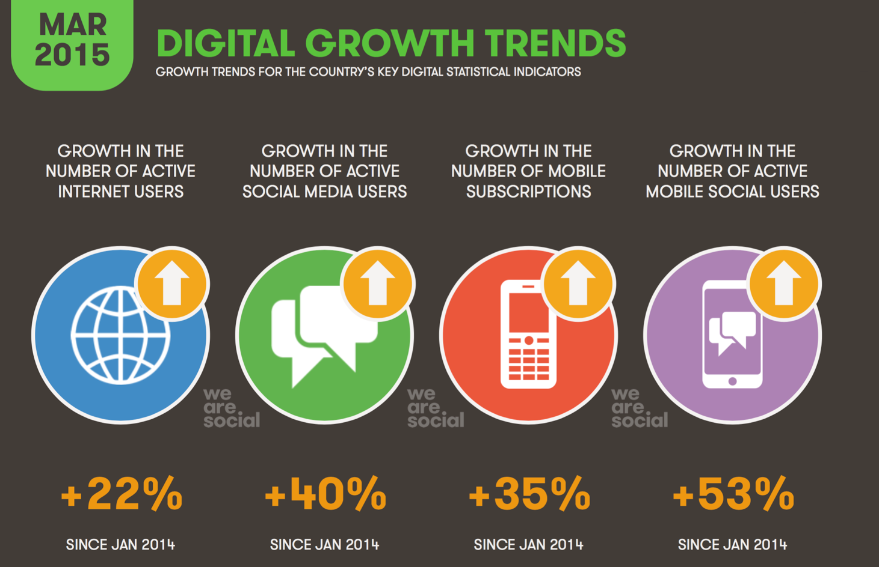
Digital marketing overview (Growth trends)
Affordable prices for electronic devices stipulate a rapid growth in the number of social mobile and social media users.
Same marketing approach as it is in APAC countries will be applicable in Sri Lanka.
Source: Digital, Social, and Mobile in APAC, 2015 (IAB Singapore)

Slide 24
Top 5 traffic receiving web-sites
№ | Top 5 traffic receiving web-sites | Visits per months, not unique
1 | Google.lk | 30 700 000
2 | Facebook.com | 30 000 000
3 | Hirufm.lk* | 2 695 000
4 | Ikman.lk ** | 2 912 000
5 | Gossiplankanews.com*** | 2 263 000
The main sources of our customers are Google and Facebook
Google Adwords (Display network) enables us to display brief advertising copy to web users, based in part on cookies and predefined keywords. For example Gossiplanlkanews.com (see bottom right picture) is designed to allow Google to select and display advertising copy.
Ikman.lk (bottom left picture) is an example of traffic partners, which websites contain a space for prepaid digital advertisements. This advert is represented to every website user within particular prepaid period of time.
* Hiru FM,The No 01 online Radio in Sri Lanka.
** Ikman.lk is a free online classified website where you can buy and sell almost everything
*** Underground News from Sri Lanka.

Slide 25
Customer acquisition & Marketing cost
# | Marketing tools* | Sales volume | Impressions | Clicks | CTR | CPC | Monthly budget | CR CPC/ Long app | Long apps | Long app cost | Total WEB CR | Applications in TS | Disbursement | Sales | Client cost
1 | Facebook | 55% | 14 000 000 | 140 000 | 1,0% | $0,14 | $19 600 | 5,0% | 7 000 | $2,80 | 5% | 7 000 | 20% | 1 400 | $14,00
2 | Display Network | 29% | 150 000 000 | 75 000 | 0,05% | $0,12 | $9 000 | 5,0% | 3 750 | $2,40 | 5% | 3 750 | 20% | 750 | $12,00
3 | Organic | 9% |  |  |  |  | $0 | 5,0% | 1 176 | $0 | 5% | 900 | 20% | 180 | $)
4 | Traffic partners | 5% |  |  |  |  | $2 000 | 5,0% | 588 | $3,40 | 5% | 450 | 20% | 90 | $22,22
5 | Google Search Ad | 2% | 80 000 | 4 000 | 5,0% | $0,33 | $1 320 | 5,0% | 200 | $6,60 | 5% | 200 | 20% | 40 | $33,00
 | Total | 100% |  |  |  |  | $31 920 |  | 12 715 | $2,51 |  | 12 300 |  | 2 460 | $12,98
The calculation is based on current statistical data. Having 40% annual growth of social media users and 22% annual growth of internet users, the projected sales volumes shall grow respectively.
Our digital marketing experience in Philippines, Indonesia, Malaysia and Vietnam allows us to manage local marketing mix for achieving the optimal cost per client

Slide 26
Sales plan
Short term sales plan
 | Month 1 | Month 2 | Month 3 | Month 4 | Month 5 | Month 6
Number of loans disbursed per month | 100 | 300 | 600 | 900 | 1 200 | 1 500
Long term sales plan
 | EOY1 | EOY2 | EOY3 | EOY4 | EOY5
Number of loans disbursed per month | 7 216 | 17 395 | 25 878 | 33 708 | 35 504
Share of new sales, % | 43% | 27% | 27% | 26% | 26%
Share of repeat sales, % | 37% | 43% | 44% | 44% | 44%
Share of prolongations, % | 20% | 29% | 29% | 30% | 30%

Slide 27
6. Decision making and collection

Slide 28
Credit and Limit Policy
# | Rule | Description
1 | Customer segment | All customers, valid bank account is obligatory
2 | Loan amount | max $110 (15 000 Rupees) for customers who are registered in Colombo max $70 (10 000 Rupees) in other regions Loan amount does not exceed 30% of customer’s average monthly net Income Exact loan amount depends on the region and customer’s age and it is to be chosen from the list of 5 values [15 000; 12 500; 10 000; 7 500; 5 000 Rs]
3 | Tenure | 7, 15, 21, 30 days
4 | ID copy | not required
5 | Identification | Done by the Bank at the stage of account opening
6 | Address proof doc | Copy of the document is not required
7 | Income proof doc | Copy of the document is not required
8 | Credit bureau | No access to credit bureau at current stage. Currently we are building a partnership with lending institution to obtain credit information available with credit bureau
9 | Anti-fraud auto checks | Following customer’s data to be cross-checked against existing customers who are delinquent: phone numbers, bank account numbers, IDs, contact and work phones, IPs, Devices.
10 | Work phone in application form | It has to be properly declared in the application
11 | Contact person in application form | It must be properly declared in the application (we are planning to call to contact person in case of customer’s credit history absence or negative credit history is present)
12 | SMS confirmation of the phone | to be confirmed via SMS sent to customer’s phone number
13 | Verification phone requirement | Confirm identity of the customer. Confirm contact person phone number and relationship between customer and contact person.
14 | Employment & income check | Only some occupation knowledge questions (for customer and contact person)
15 | Income type & source of repayment | Customer can explain about source of repayment of the loan.
16 | Restricted occupation | Applications with following occupations must be declined: Police, Military, Communication/ Media/ PR/ Newspaper, Law/ Court.
17 | Disbursement channel | Bank transfer
18 | Repeat loan policy | Loan amounts 10 000 – 30 000 Rupees with 5 000 Rupees step, maximum cap - 50% of net monthly income

Slide 29
Risk Management tools
Credit Bureaus
Currently we are building a partnership with lending institution to obtain credit information available with credit bureau
Anti-fraud tools
Internal anti-fraud rules – cross checks of application data against historical data to detect links between applicants, find chains of fraudulent applications, highlight mismatches of data within one application.
Iovation solution – tool to prevent online-fraud, multi-applying, deliver additional variables for scoring. Solution allows to get all available data of applicant`s device (PC, smartphone where the application was submitted) and perform a cross check against historical database
Internal scoring
Can be implemented after 6-8 from go live. Will use standard application parameters, Iovation data plus additional client behavior data, captured during application filling
Social data
Facebook data (should be available for more than 50% of applicants) – we will offer optional FB authorization to the client, which will give us possibility directly got to FB API and get social data which will be used as additional variables for scoring
Messengers (Viber, WhatsUp) – will be used during verification as additional source to confirm identity and contactability of client

Slide 30
Target collections procedure
# | Stage | Short Description | Stage Period | Resources
0 | Pre – Due | SMS Notification borrower about payment Pre-due phone calls*, active prolongation sales | [- 5 … 2] days before/after due date | In-house Call center (soft collection)
1 | Soft Collection | Phone collection*, SMSs, e-mails. The threat of court action can prompt payment | [3 … 30] DPD – all clients [30-90] DPD – part of the delinquent clients | In-house Call center (soft collection)
2 | Skip tracing | Look for new contact data, addresses, employers by Google Check and Facebook | 2+ | Separate skip-tracing In-house collection team
3 | Hard Collection | Field visit to living area, work, borrower’s relatives home. The threat of court action can prompt payment | [30+] DPD – part of the delinquent clients | In-house collectors
4 | Litigation / Execution | Attorney-at-law to be outsourced | [90+] DPD – part of the delinquent clients | Outsourced
All conversations with customer will be recorded

Slide 31
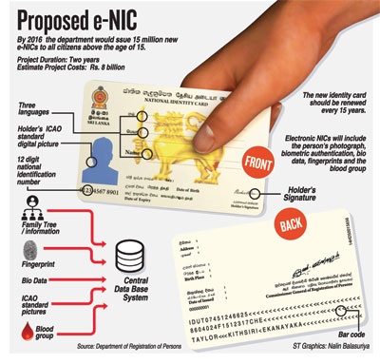
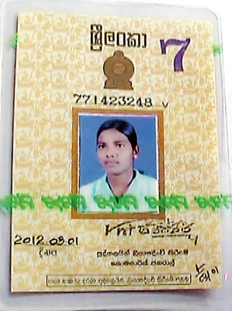
Customer identification/ banking KYC
Loans to be disbursed to bank accounts only. We believe that bank identification on account opening will fully replace internal KYC
To open an account Banks perform sophisticated check and require following documents:
Passport or National Identity Card (NIC) to confirm the Full name and the date of birth;
Utility bills or tax assessment to confirm the permanent address
Every Passport or NIC to be validated by bank employee, who must follow validation procedure (check security features, use IT system to verify ID number)
Bank may confirm the validity of the official documentation provided through certification by an authorized person
By 2016 the Registry of Persons Department would issue 15 million new e-NICs
Current NIC
Security features on the NIC
The following items fluoresce under a UV light:
Blue security fibres
The Sri Lankan Crest (image of a lion and sword within a circle) on the front of the card, above the picture (fluoresces yellow)
At the back center of the card, the Sri Lankan Crest also appears in yellow
A green line with a pattern is also a security feature, when viewed vertically, the letters RPD (Registry of Persons Department) are repeated.
The Bank is responsible for validation of personal data provided by Customer
Whoever forges an ID document shall be punished with imprisonment of description for a term of 7 years

Slide 32

Credit information bureau of Sri Lanka
Established in 1990, Credit information bureau (CRIB) is a public-private partnership, with the Central Bank holding the majority of equity while the rest is held by lending institutions regulated by the Central Bank.
CRIB currently has 94 shareholders, including all licensed Commercial banks, Specialized banks, Finance companies, Leasing companies, few other institutions which have been declared as lending institutions.
These entities supply CRIB with credit information that is transferred electronically through their head office to CRIB and CRIB, in turn, updates its database at the end of each month.
In 2008 CRIB launched a first version of an automated “Credit Information Management System” (CRIMS). The Banks and approved financial institutions access their customers’ credit information online through the bureau website.
About 3,9 million records on private individuals are in database of CRIB (out of 8,9 million employed)
The following persons are qualified to request for membership of the bureau:
Lending institutions who are shareholders of the CRIB;
The Central Bank;
Any governmental agency;
Borrowers and prospective borrowers;
International credit bureaus;
Insurance companies;
other persons or bodies of persons (recommended by the Monetary Board).
The access to bureau can be obtained through partnership with one of the CRIB shareholder.
A respective procedure is under discussion. Preliminary the following can be implemented:
Phone verifier sends a request to our partner (customer’s ID provided) via email/messenger;
Partner’s employee gets CRIB report using bureau website and sends the report back to phone verifier;
Phone uploads obtained report or data about report absence to customer’s profile;
Unless we obtain a direct access to credit bureau we can get respective reports via partnership with lending institution
Currently CRIB records cover 44% of employed people which gives us an opportunity to obtain relevant data
Microfinance Act allowed licensed microfinance companies request for a membership of the CRIB.
Sources: www.crib.lk and CRIB Act http://www.crib.lk/en/images/act/ACT.pdf

Slide 33
Risk Loss curve
Start with the Credit rules, Anti-fraud rules, Phone verifications
Selective credit bureau check
Customer’s long term repayment behavior identified
Facebook data usage
Unsatisfactory customers identified and filtered out
Implement the first internal score card updated each 2-3 months
Using web history data, update of score card
Internal score card with a 1 year maturity of client’s payment details identified
We expect the risk loss for new loans to be 30~40% at the beginning and then decrease to 20% EOY1 and then to stabilize at the level of 15% for New loans and 11% for Repeat at EOY2.
From year to year risk will continue to decreasing as a result of risk strategies optimization.

Slide 34
7. IT

Slide 35
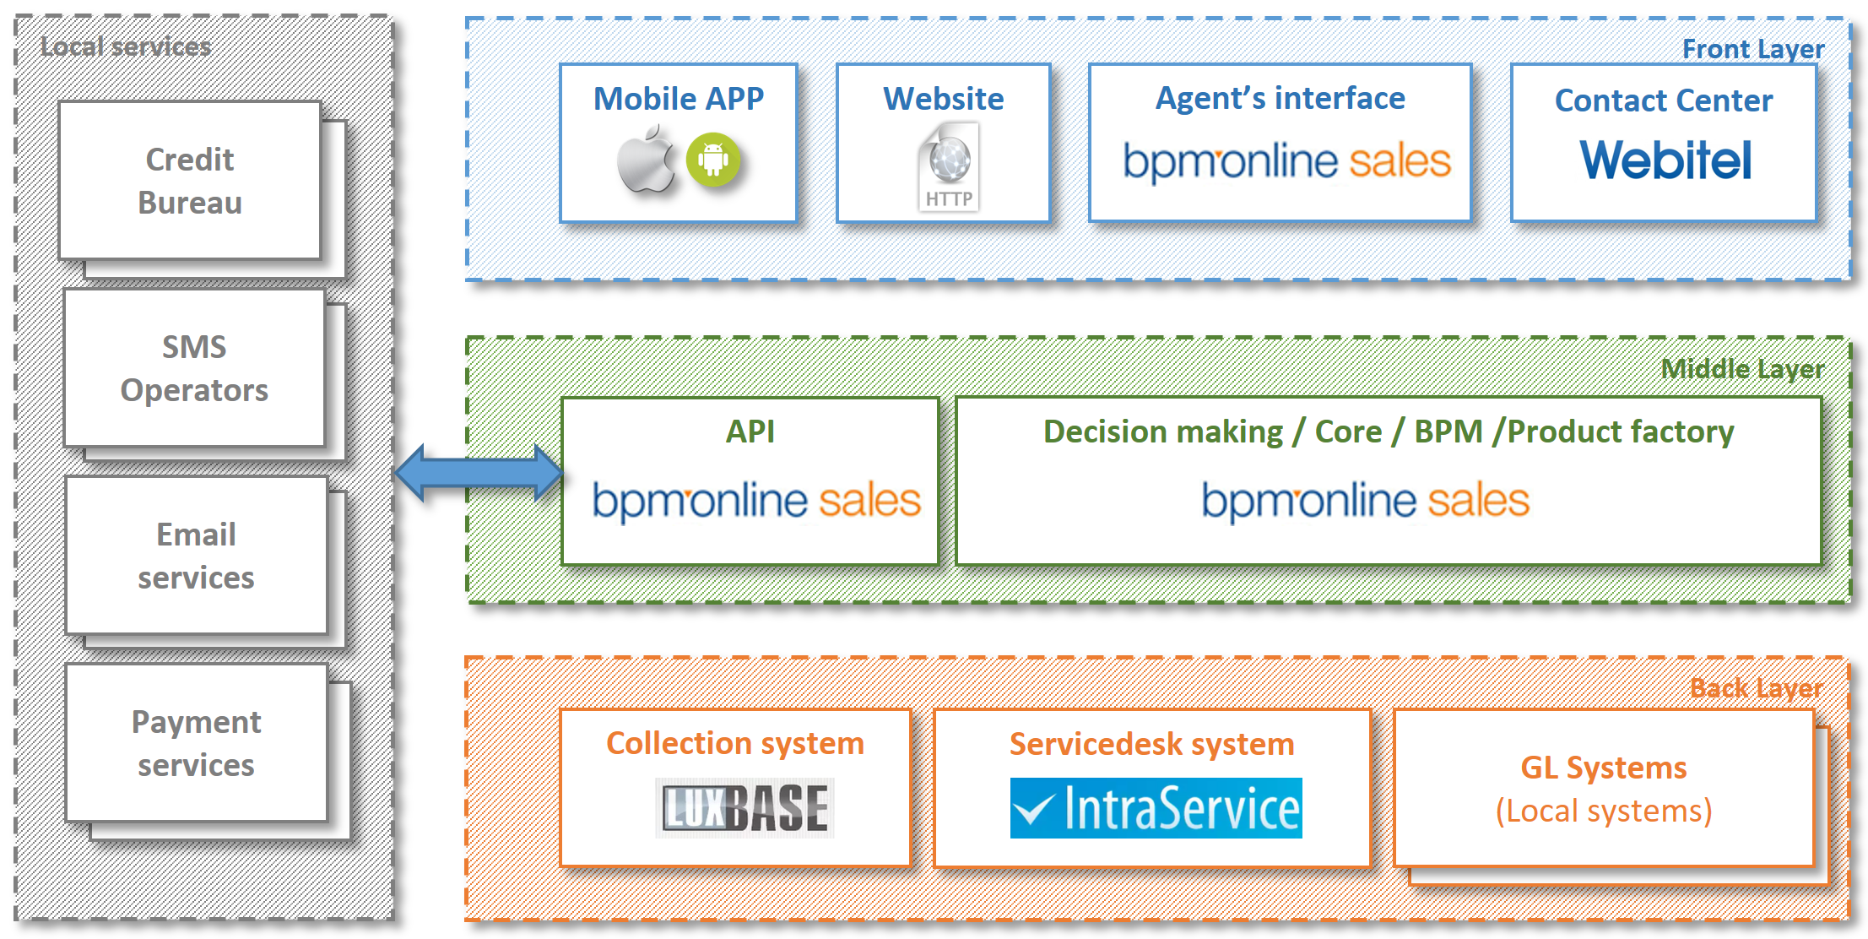
IT architecture

Slide 36
Integration scope of work
# | Integration partner | Type of the partner | Comments
1 | TextWare (Private) Limited http://textware.lk | SMS Aggregator | The company has integration points with all mobile operators in the country
2 | Sampath Bank http://www.sampath.lk/en/ | Payment/ disbursement agent | The most technologically advanced bank in the market
3 | Pass accounting solution | Payment/ disbursement agent (alternative) | Company that has required software and an experience of distributing money to customers’ accounts
4 | Cargills Food cities, Keels Super Markets, Singer Outlets | Repayment partner | Retail networks
5 | BizPay https://www.bizpay.lk/BizPayIPG/PaymentGateway | Repayment partner | Multi-channel payment platform
6 | SCIENTER TECHNOLOGIES http://scienter.lk | GL system supplier | Scienter tech provides eFinancials software for finance companies
7 | OpenArc Systems Management http://openarc.lk | GL system supplier (alternative) | InBank solution developed by OpenArc gives its customers graphical user interface (GUI) to optimise profit through GL data

Slide 37
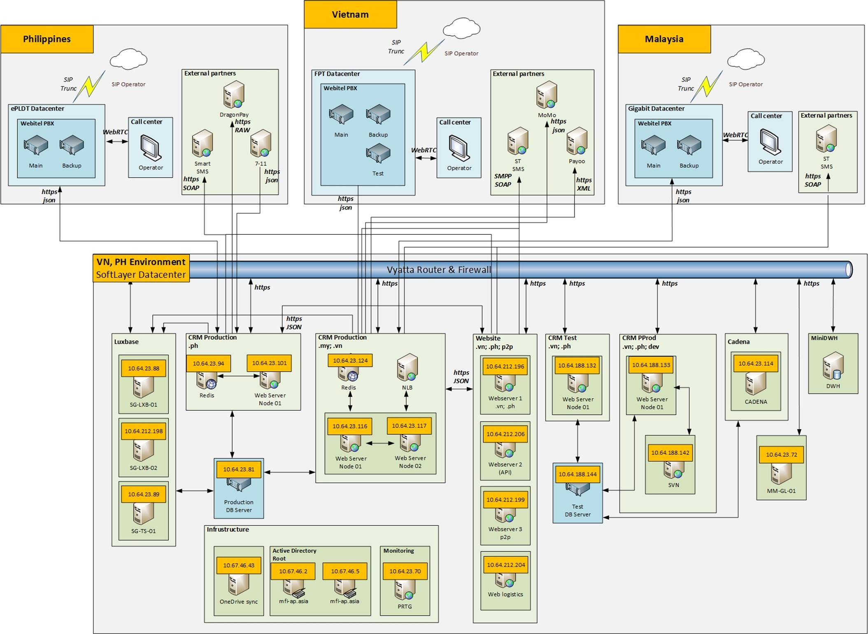
IT architecture geo layout

Slide 38
IT expenses: One-off and Fixed
One-off IT expenses | Values, USD
Web sites | -7 000
Mobile sites&app | -4 000
Collection system implementation | -8 000
СRM development | -56 400
Total: | -75 400
Fixed IT expenses, USD | Year 1 | Year 2 | Year 3 | Year 4 | Year 5
Internet | -24 000 | -30 000 | -30 000 | -30 000 | -30 000
Data center rent | -42 000 | -12 000 | -12 000 | -12 000 | -12 000
CC license | -7 254 | -11 718 | -6 975 | -7 533 | -1 674
GL license | -1 000 | -1 000 | -1 000 | -1 000 | -1 000
CRM Development - fixed part | -27 500 | -30 000 | -30 000 | -30 000 | -30 000
Software support | -27 000 | -27 000 | -27 000 | -27 000 | -27 000
Total: | -131 754 | -144 718 | -139 975 | -140 533 | -134 674

Slide 39
8. HR & Admin Information

Slide 40
Organization chart – Initial (up to 3 months)
Total 11 people

Slide 41
Organization chart – end of year 1
Total 67 people

Slide 42
Organization chart – end of year 5
Total 180 people

Slide 43
Headcount and Personnel budget
Group/Position | Gross costs of employment, USD | Headcount |  |  |  |  | Monthly cost of employment, USD
 |  | EOY 1 | EOY 2 | EOY 3 | EOY 4 | EOY 5 | EOY 1 | EOY 2 | EOY 3 | EOY 4 | EOY 5
Total staff (fixed+variable) |  | 67 | 119 | 137 | 171 | 180 | 65 050 | 91 350 | 98 350 | 113 050 | 117 000
Total fixed staff |  | 22 | 23 | 23 | 23 | 23 | 45 000 | 50 000 | 50 000 | 50 000 | 50 000
Mangement and direct reports |  | 3 | 4 | 4 | 4 | 4 | 11 000 | 16 000 | 16 000 | 16 000 | 16 000
Operations department |  | 3 | 3 | 3 | 3 | 3 | 6 500 | 6 500 | 6 500 | 6 500 | 6 500
Risk department |  | 5 | 5 | 5 | 5 | 5 | 7 600 | 7 600 | 7 600 | 7 600 | 7 600
Financial department |  | 3 | 3 | 3 | 3 | 3 | 5 400 | 5 400 | 5 400 | 5 400 | 5 400
Legal department |  | 1 | 1 | 1 | 1 | 1 | 3 000 | 3 000 | 3 000 | 3 000 | 3 000
Digital marketing department |  | 2 | 2 | 2 | 2 | 2 | 4 000 | 4 000 | 4 000 | 4 000 | 4 000
IT department |  | 1 | 1 | 1 | 1 | 1 | 2 500 | 2 500 | 2 500 | 2 500 | 2 500
HR department |  | 4 | 4 | 4 | 4 | 4 | 5 000 | 5 000 | 5 000 | 5 000 | 5 000
Total variable staff |  | 45 | 96 | 114 | 148 | 157 | 20 050 | 41 350 | 48 350 | 63 050 | 67 000
Operations department |  | 22 | 43 | 55 | 73 | 77 | 9 550 | 17 850 | 22 050 | 29 450 | 31 200
Verificator Teamleader | 700 | 1 | 1 | 1 | 2 | 2 | 700 | 700 | 700 | 1 400 | 1 400
Verificator | 450 | 8 | 14 | 14 | 18 | 18 | 3 600 | 6 300 | 6 300 | 8 100 | 8 100
Telesale operators Teamleader | 700 | 1 | 2 | 2 | 3 | 3 | 700 | 1 400 | 1 400 | 2 100 | 2 100
Telesale operators | 350 | 7 | 17 | 26 | 34 | 36 | 2 450 | 5 950 | 9 100 | 11 900 | 12 600
Customer support Teamleader | 700 | 1 | 1 | 1 | 1 | 2 | 700 | 700 | 700 | 700 | 1 400
Customer support | 350 | 4 | 8 | 11 | 15 | 16 | 1 400 | 2 800 | 3 850 | 5 250 | 5 600
Risk department |  | 23 | 53 | 59 | 75 | 80 | 10 500 | 23 500 | 26 300 | 33 600 | 35 800
Telecollector Teamleader | 700 | 2 | 3 | 3 | 4 | 4 | 1 400 | 2 100 | 2 100 | 2 800 | 2 800
Telecollector | 400 | 16 | 38 | 40 | 51 | 54 | 6 400 | 15 200 | 16 000 | 20 400 | 21 600
Field collector Teamleader | 700 | 1 | 1 | 1 | 2 | 2 | 700 | 700 | 700 | 1 400 | 1 400
Field collector | 500 | 4 | 11 | 15 | 18 | 20 | 2 000 | 5 500 | 7 500 | 9 000 | 10 000

Slide 44
8. Finance

Slide 45
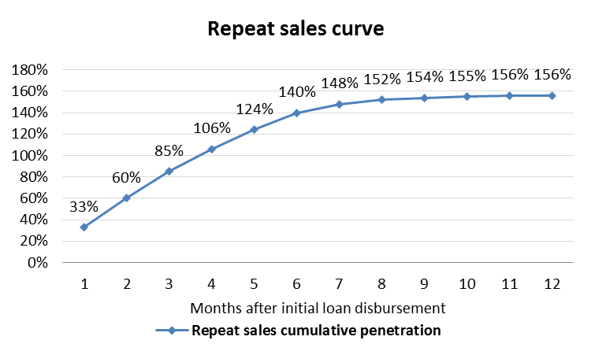
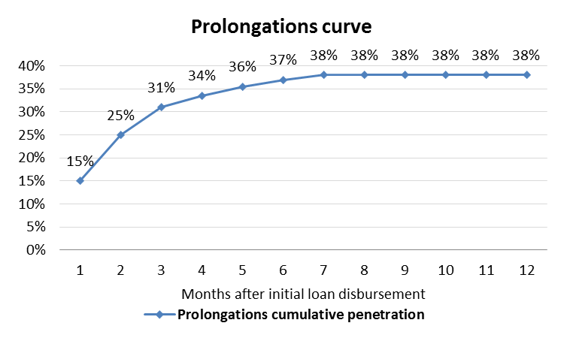
Financial model assumptions
Loan type | Avg term, days | Avg ticket, USD | Losses, %
New | 26 | 90 | 14.8%
Repeat | 26 | 160 | 11.3%
Prolongation new | 30 | 90 | 25.0%
Prolongation repeat | 30 | 160 | 25.0%
Product parameters | Value
Normal interest rate, per day | 1.11%
Late penalty interest rate, per day | 1.50%
Late payment fee, USD | 10
Year of project | 1 | 2 | 3 | 4 | 5
MAC, USD per loan | 48 | 10 | 10 | 10 | 10
Repeat sales per new loans | 156%
Prolongations per all loans | 38%

Slide 46
Investment summary
Investments, thsd USD | Year 1 | Year 2 | Year 3 | Year 4 | Year 5 | Total
Portfolio investments | 1 295 | 1 430 | 126 | 0 | 0 | 2 851
OPEX and CAPEX investments | 1 148 | 161 | 0 | 0 | 0 | 1 309
Total investments | 2 444 | 1 591 | 126 | 0 | 0 | 4 161
Volume indicators | Year 1 | Year 2 | Year 3 | Year 4 | Year 5 | Total
Number of loans issued, thsd | 32 | 158 | 264 | 362 | 422 | 1 238
Amount disbursed, thsd USD | 3 088 | 15 408 | 25 527 | 34 957 | 40 642 | 119 622
Net portfolio (EoY), thsd USD | 789 | 2 054 | 3 163 | 4 146 | 4 410 | 14 561
P&L, thsd USD | Year 1 | Year 2 | Year 3 | Year 4 | Year 5 | Total
Revenue | 810 | 5 328 | 9 502 | 13 431 | 16 034 | 45 105
Provisions | -659 | -2 931 | -4 479 | -5 540 | -6 472 | -20 081
Variable costs | -563 | -1 407 | -2 256 | -3 096 | -3 606 | -10 929
Marketing acquisition costs | -385 | -527 | -815 | -1 087 | -1 206 | -4 020
Salary (variable part) | -127 | -388 | -516 | -680 | -796 | -2 506
Other variable costs | -20 | -69 | -96 | -128 | -148 | -462
VAT | -32 | -424 | -829 | -1 200 | -1 456 | -3 941
Fixed costs | -1 016 | -1 125 | -1 036 | -1 141 | -1 171 | -5 490
Salary (fixed part) | -709 | -807 | -726 | -826 | -886 | -3 954
Other G&A expenses | -307 | -318 | -310 | -315 | -286 | -1 536
One-off expenses | -49 | -15 | -15 | -15 | -15 | -109
Net profit before taxes | -1 476 | -151 | 1 715 | 3 639 | 4 769 | 8 496
Terminal value |  |  |  |  |  | 20 968
ROE (annualized) |  |  |  |  |  | 60%
ROAA (yearly) | -187% | -11% | 64% | 72% | 80% | 51%
Break-even period – 17 months
Self-capitalization period – 26 months
Payback period – 56 months
Total investments from – $4,2M
Unoptimized Yr5 corporate tax – $1,3M
Terminal Value – $21,0M (Gordon growth model with discount factor 15% and growth rate 0%)

Slide 47
Balance sheet
Balance Sheet (EOY)
thsd USD | Year 1 | Year 2 | Year 3 | Year 4 | Year 5
Assets | 967 | 2 407 | 3 668 | 4 783 | 5 071
Liquid assets | 118 | 308 | 474 | 622 | 661
Loans to individuals (net of provisions) | 789 | 2 054 | 3 163 | 4 146 | 4 410
Total loans | 1 447 | 5 644 | 11 232 | 17 755 | 24 491
Risk provisions | -659 | -3 590 | -8 069 | -13 609 | -20 081
Other receivables | 60 | 45 | 30 | 15 | 0
Shareholders' equity | 967 | 2 407 | 3 668 | 4 783 | 5 071
Contributed equity | 2 444 | 4 034 | 4 161 | 4 161 | 4 161
Retained earnings | -1 476 | -1 627 | 35 | 2 655 | 6 089
Dividends paid | 0 | 0 | -528 | -2 033 | -5 179
Equity+Liabilities | 967 | 2 407 | 3 668 | 4 783 | 5 071

Slide 48
P&L Statement
P&L
thsd USD | Year 1 | Year 2 | Year 3 | Year 4 | Year 5 | Total
Revenue | 810 | 5 328 | 9 502 | 13 431 | 16 034 | 45 105
Primary sales | 363 | 1 682 | 2 748 | 3 784 | 4 330 | 12 907
Repeat Sales | 448 | 3 646 | 6 754 | 9 647 | 11 704 | 32 198
Risk provisions | -659 | -2 931 | -4 479 | -5 540 | -6 472 | -20 081
Primary sales | -356 | -1 084 | -1 503 | -1 801 | -2 013 | -6 756
Repeat Sales | -303 | -1 848 | -2 976 | -3 739 | -4 459 | -13 325
Variable costs* | -563 | -1 407 | -2 256 | -3 096 | -3 606 | -10 929
Marketing acquisition costs | -385 | -527 | -815 | -1 087 | -1 206 | -4 020
Salary (variable part) | -127 | -388 | -516 | -680 | -796 | -2 506
Other variable costs | -20 | -69 | -96 | -128 | -148 | -462
VAT | -32 | -424 | -829 | -1 200 | -1 456 | -3 941
Operating profit (before fixed costs) | -412 | 990 | 2 766 | 4 795 | 5 955 | 14 095
Fixed costs* | -1 016 | -1 125 | -1 036 | -1 141 | -1 171 | -5 490
Salary (fixed part) | -709 | -807 | -726 | -826 | -886 | -3 954
Other G&A expenses | -307 | -318 | -310 | -315 | -286 | -1 536
One-off expenses | -49 | -15 | -15 | -15 | -15 | -109
Profit before Taxes** | -1 476 | -151 | 1 715 | 3 639 | 4 769 | 8 496
* See slides 50-51 for details
** Estimated unoptimized amount of profit tax for 5th year is $1.3M

Slide 49
Cash flow statement
Cash flow
thsd USD | Year 1 | Year 2 | Year 3 | Year 4 | Year 5 | Total
Loans issued | -3 088 | -15 408 | -25 527 | -34 957 | -40 642 | -119 622
Principals received | 1 640 | 11 212 | 19 939 | 28 435 | 33 906 | 95 131
Interest received | 810 | 5 328 | 9 502 | 13 431 | 16 034 | 45 105
Loan fees received | 0 | 0 | 0 | 0 | 0 | 0
Fines & penalties received | 0 | 0 | 0 | 0 | 0 | 0
Total CF from business activities: | -637 | 1 132 | 3 913 | 6 909 | 9 298 | 20 614
Commissions to agents & payment systems | -3 | -3 | -3 | -3 | -4 | -16
POS costs | 0 | 0 | 0 | 0 | 0 | 0
People costs | -826 | -1 140 | -1 150 | -1 379 | -1 531 | -6 025
Marketing & Acquisition costs | -394 | -582 | -908 | -1 215 | -1 356 | -4 454
Support costs | -11 | -29 | -35 | -46 | -47 | -169
Office costs | -183 | -216 | -228 | -255 | -245 | -1 127
IT costs | -176 | -103 | -103 | -103 | -103 | -588
Professional services | -20 | 0 | 0 | 0 | 0 | -20
Other income (expenses) | -43 | -36 | -36 | -36 | -36 | -187
Profit tax | 0 | 0 | -53 | -1 019 | -1 335 | -2 407
VAT paid | -32 | -424 | -829 | -1 200 | -1 456 | -3 941
Working Capital required | 0 | 0 | 0 | 0 | 0 | 0
Total CF from operating expenses: | -1 688 | -2 532 | -3 345 | -5 256 | -6 113 | -18 935
Total CF from operating activities: | -2 325 | -1 401 | 568 | 1 652 | 3 185 | 1 679
Financing received | 2 444 | 1 591 | 126 | 0 | 0 | 4 161
Financing returned | 0 | 0 | -528 | -1 505 | -3 145 | -5 179
Interest expense | 0 | 0 | 0 | 0 | 0 | 0
Total CF from financing activities: | 2 444 | 1 591 | -402 | -1 505 | -3 145 | -1 018
CAPEX | 0 | 0 | 0 | 0 | 0 | 0
Total CF for the period: | 118 | 190 | 166 | 147 | 40 | 661
Cash balance beginning: | 0 | 118 | 308 | 474 | 622 | 622
Cash balance ending: | 118 | 308 | 474 | 622 | 661 | 661

Slide 50
Expenses detailed
Variable costs, thsd. USD
Expenses category | Year 1 | Year 2 | Year 3 | Year 4 | Year 5 | Total
Marketing acquisition costs | -385 | -527 | -815 | -1 087 | -1 206 | -4 020
Salary (variable part) | -127 | -388 | -516 | -680 | -796 | -2 506
Other variable costs | -20 | -69 | -96 | -128 | -148 | -462
Telecommunications - acquisition | -6 | -20 | -28 | -38 | -44 | -135
Outbound SMS - acquisition | -3 | -12 | -20 | -27 | -31 | -92
Payment system fees | -3 | -3 | -3 | -3 | -4 | -16
Telecommunications - support | -7 | -29 | -36 | -48 | -56 | -177
Outbound SMS - support | -1 | -5 | -9 | -12 | -14 | -41
VAT | -32 | -424 | -829 | -1 200 | -1 456 | -3 941
Total | -563 | -1 407 | -2 256 | -3 096 | -3 606 | -10 929
Fixed costs, thsd. USD
Expenses category | Year 1 | Year 2 | Year 3 | Year 4 | Year 5 | Total
Salary (fixed part) | -709 | -807 | -726 | -826 | -886 | -3 954
Salary | -484 | -570 | -600 | -600 | -600 | -2 854
Bonuses | -225 | -237 | -126 | -226 | -286 | -1 100
Other G&A expenses | -307 | -318 | -310 | -315 | -286 | -1 536
Rent/office expenses | -133 | -138 | -134 | -139 | -115 | -658
IT expenses | -132 | -145 | -140 | -141 | -135 | -692
Miscellaneous | -43 | -36 | -36 | -36 | -36 | -187
Total | -1 016 | -1 125 | -1 036 | -1 141 | -1 171 | -5 490

Slide 51
One-off expenses
Expenses category | Total, thsd USD
HR expenses | -20
Recruiting | -20
IT expenses | -89
СRM development | -56
Call center implementation | -14
Collection system implementation | -8
Web sites | -7
Mobile sites&app | -4
Total | -109

Slide 52
9. Project plan

Slide 53

Project Plan
Activity | Planning end date | Comments
Hiring a COO | 28/09/2016 | We already have the candidate.
Incorporating a company | 28/10/2016 | We plan to prepare documents in middle of September
Renting office | 31/10/2016 | We plan to rental office by the end of September
Building team | 15/11/2016 | We planning to use requiting agency for hiring top employees
IT settings, product settings | 25/12/2016 | We understand all our partners for integration
Official documents | 15/11/2016 | We will use law advisor company for preparing all documents
Start pilot sales | 20/11/2016
Start operations | 25/12/2016
Activity | Sept-16 | Oct-16 | Nov-16 | Dec-16 | Jan-17
Incorporating a company
Renting office
Creating team
IT Development, product settings
Official documents for customers
Start pilot sales
Start operations

Slide 54
10. Annexes

Slide 55
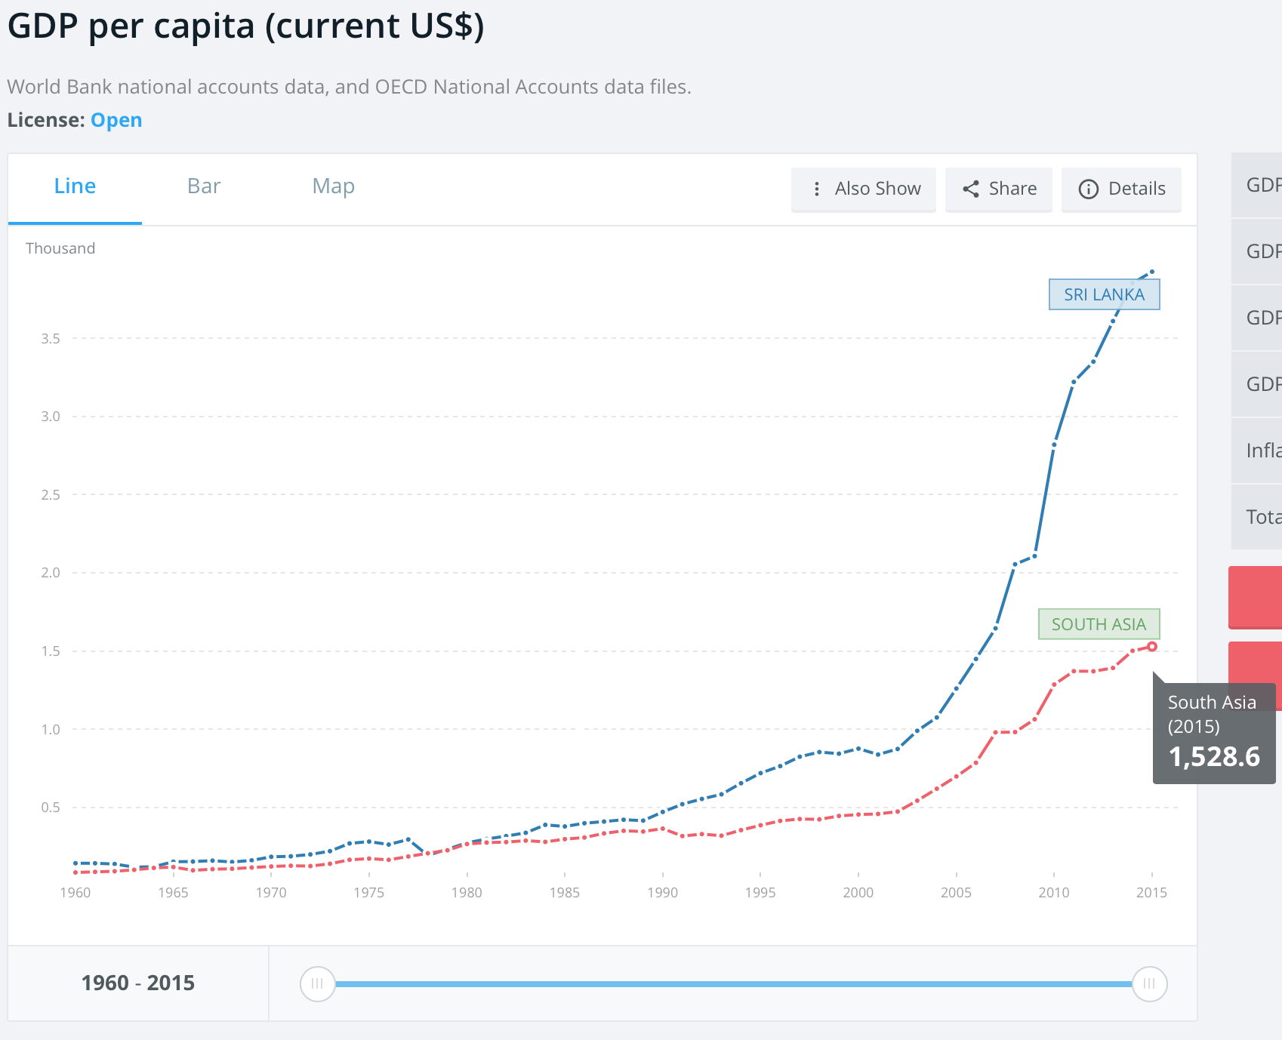
Annex 1: GDP per capita growth
the Sri Lankan military defeated the Tamil Tigers in May 2009, bringing the civil war to an end
Cease-fire was declared in December 2001
Source: [World Bank, World Development Indicators]

Slide 56
Annex 2: GDP per person employed
Whereas Sri Lanka, Indonesia, and Philippines have similar GDP per capita in the range of 3,2-3,9 (difference 22%), GDP per employed person in Sri Lanka significantly hirer than in that of Philippines and Indonesia (difference 53%):
Sri Lanka – $ 26 021
Indonesia - $ 21 958
Philippines - $ 17 120
Source: [World Bank, World Development Indicators]

Slide 57
Annex 3: ATM & Branches penetration
Source: International Monetary Fund, Financial Access Survey (World Data Bank)
Source: International Monetary Fund, Financial Access Survey (World Data Bank)
Source: [World Bank, World Development Indicators]

Slide 58
Annex 4: Employment by Economic Activity
Source: Central Bank of Sri Lanka, Annual report 2015

Slide 59
Annex 5: Cash flow
Singapore
Sri Lanka
APV
Digital money lender
Borrowers
Funds remittance
Singaporean
Bank account
in USD
Net profit
Sri Lankan
Securities Investment account in USD
Capital top up
(OPEX + Funds)
Bank account in Rupees
(designated for disbursements)
Disbursement
Borrowers’ Bank accounts in Rupees
Net profit (Dividends)
Bank account in Rupees
(designated for repayments collection)
Repayments
(Service Fee, Interest, Principal)
MM
LGC
Funds remittance
Service fee
Singaporean
Bank account
in USD
Sri Lankan
Securities Investment account in USD
Capital top up
(OPEX)
Bank account in Rupees
Net profit
Net profit (Dividends)

Slide 60
Annex 6: Incorporation procedure
Activities | Week 1 | Week 2 | Week 3 | Week 4 | Week 5 | Week 6 | Week 7 | Week 8 | Week 9
1) Obtain approval from Registrar for a name of the company
2) Prepare documents required for company incorporation
3) Obtain the certificate of incorporation
4) Incorporated company can be used for non-financial purposes
5) Transfer shares to foreign company
6) The entire operations can be launched
7) Give notice to the Registrar General of Companies
8) Obtain public notice*
4 weeks
3 weeks
4 weeks
The list of documents required for incorporation consists of the following:
Application for incorporation
Articles of association of the company signed by each of the initial shareholders (initial shareholder is a local citizen who consequently transfers shares to foreign company)
Consent from each of the initial directors to act as directors of the company
Consent from the initial secretary** to act as the secretary of the company (Secretarial services to be provided by Corporate Services (Private) Limited associated with F.J.&G. De Seram).
Legal consultant – F.J.&G. De Seram
Expenses related to company incorporation ($ 1400):
Legal fees for attending to the incorporation of a company ($ 1000)
Cost of filing the forms for incorporation ($ 140)
The public notice of incorporation in newspapers published in Sinhala, English and Tamil languages ($100)
Fee for providing secretarial services ($100)
* - The details specified in the Companies Act will be publishing in the Government Gazette and a Sinhala, Tamil and an English newspaper
** - Secretarial functions include convening meetings of directors and shareholders of the company; acting as Secretaries to all such meetings; keeping minutes and records thereof; and of circular resolutions; filing all returns and forms at the RGOC; maintaining all statutory books, except books of account.

Slide 61






Annex 7: Repayment procedure
Terrasoft
1. Customer sends repayment to Bank account
2. Accountant checks bank account using online banking on daily basis
3. As soon as incoming repayment detected accountant reflects it in Terrasoft
4. Transoft initiates immediate loan repayment procedure
Narrative is required (details about fulfilling provided in SMS sent to customer)
RP IT System
Repayment partners (RP)
1. RP requests Customer to show personal ID
2. RP identifies a validity of personal ID via its IT system
3. RP collects repayment, reflects it in IT system
4. RP IT system sends info online about the payment to TS
6. RP prints out the check, gives it to customer
Terrasoft
5. TS initiates immediate loan repayment procedure
Web interface
Payment platform
1. Customer fulfil web form with: Loan ID + Amount to be paid
2. Customer provides RP platform with payment card details
3. RP platform initiate debiting procedure
4. RP platform sends online payment details to the TS
6. RP platform sends electronic confirmation to customer’s email

Slide 62
Annex 8: Facebook user details
The majority of Facebook users are men (70%) between the ages of 18 and 34 (77%), 62% of whom are single.
Predominantly people use mobile devices to access Facebook content. Although Android is commonly widespread, mobile web and feature phones are also popular way of accessing social media in Sri Lanka.

Slide 63
Annex 9: Markets comparison
Country statistics | VN | PH | ID | MY | CN | MM | LK
Population, mln | 91 | 101,9 | 255 | 31 | 1 376 | 51 | 21
GDP per capita (nominal), thsd USD | 2,3 | 3,2 | 3,5 | 12,2 | 8,8 | 1,4 | 3,9
GDP per person employed, thsd USD | 9,3 | 17,1 | 21,9 | 55,7 | 23,1 | 3,3 | 26,0
Labor force ratio | 62% | 63% | 67% | 66% | 58,3 | 68% | 42%
Average monthly salary, USD | 200 | 208 | 250 | 961 | 730 | 120 | 233
Smartphone penetration | 20% | 50% | 25% | 63% | 56% | 58% | 41%
Bank account penetration | 21% | 27% | 20% | 66% | 64,7% | 5% | 83%
Volume indicators (year 5) | VN | PH | ID | MY | CN | MM | LK
Loans issued in year 5, thsd including prolongations | 1 291 | 441 | 464 | 198 | 1154 | 620 | 422
Loans issued per day in year 5 including prolongations | 3537 | 1208 | 1271 | 542 | 3160 | 1698 | 1156
Investment parameters | VN | PH | ID | MY | CN | MM | LK
Investment, mln USD | 15,7 | 8,8 | 11,0 | 8,6 | 31,4/15,8* | 4,5 | 4,2
capex + opex | 5,1 | 4,1 | 4,4 | 4,7 | 12,2 | 3,3 | 1,3
portfolio financing | 10,6 | 4,8 | 6,6 | 3,9 | 3,4 | 1,1 | 2,8
Break-even period, months | 15 | 20 | 20 | 18 | 25 | 22 | 17
Payback period, months | 19 | 49 | 50 | 51 | 45 | 31 | 56
Revenue, (Year 5), mln USD | 71 | 42,2 | 53,9 | 37,3 | 130 | 18,5 | 45
Profit before taxes, (Year 5), mln USD | 19 | 15,5 | 16,8 | 15,3 | 42 | 5,5 | 8,5
*China investments total $31,4 mln (15,8 investments + 15,5 debt financing)

Slide 64
Annex 10: new business vs. old business plan
№ | Parameter | New business plan | Old business plan
1 | Loans disbursed, thsd | 1 238 | 2 863
2 | Total amount disbursed, thsd USD | 119 622 | 460 828
3 | Total investment, thsd USD | 4 161 | 61 553 50 935(portfolio) + 9068 (opex) + 1 550 (license)
4 | Revenue | 45 105 | 151 266
5 | Profit before tax | 8 496 | 14 087
6 | ROE | 60% | ---
7 | Break even | 17 | 24
8 | Pay Back, months | 56 | 72

Slide 65
Annex 11.1 Core team salary expenses
№ | Employee position | Level | LK monthly salary | APAC average salary | Difference | Joining period
1 | Chief Executive Officer | B | $ 5 000 | - | - | up to 16 months
2 | Chief Operating Officer | B-1 | $ 4 000 | $ 3 671 | +329 | up to 3 months
3 | Head of call center | B-2 | $ 1 500 | - | +441 | up to 3 months
4 | Head of collection | B-2 | $ 2 000 | $ 2 040 | -40 | up to 3 months
5 | Chief Risk Officer | B-1 | $ 3 500 | $ 4 280 | -780 | up to 3 months
6 | Credit risk manager | B-2 | $ 700 | - | - | up to 6 months
7 | Anti-fraud manager | B-2 | $ 700 | - | - | up to 6 months
8 | Collection analyst | B-2 | $ 700 | - | - | up to 9 months
9 | Chief Financial Officer | B-1 | $ 4 000 | $ 5 416 | -1416 | up to 3 months
10 | Disbursement & repayment manager | B-2 | $ 1 000 | - | - | up to 3 months
11 | Accountant/ Financial manager | B-2 | $ 700 | - | - | up to 12 months
12 | Reporting manager | B-2 | $ 700 | - | - | up to 12 months
13 | HR Director | B-1 | $ 3 000 | $ 2 302 | +698 | up to 3 months
14 | Recruitment manager | B-2 | $ 600 | - | - | up to 12 months
15 | Training & development manager | B-2 | $ 800 | - | - | up to 12 months
16 | Personal admin & payroll manager | B-2 | $ 600 | - | - | up to 12 months
17 | Head of Sales & Marketing | B-1 | $ 3 000 | $ 2 137 | +863 | up to 3 months
18 | Digital sales manager | B-2 | $ 1 000 | - | - | up to 12 months
19 | Legal manager | B-1 | $ 3 000 | - | - | up to 3 months
20 | Business development manager | B-1 | $ 3 000 | - | - | up to 12 months
21 | IT Manager | B-1 | $ 2 500 | $ 2 224 | +276 | up to 3 months
22 | Quality control manager | B-1 | $ 1 000 | $ 959 | -41 | up to 12 months
 | Total: |  | $ 43 000

Slide 66
Annex 11.2 Mass team salary expenses
№ | Employee position | LK monthly salary | APAC average salary | Difference | EOY1 total expense | EOY2 total expense | EOY3 total expense | EOY4 total expense | EOY5 total expense
1 | Phone verification team lead | $ 1 000 | $ 1 315 | - 315 | $ 12 000 | $ 12 000 | $ 12000 | $ 20 000 | $ 24 000
2 | Phone verifier | $ 450 | $ 354 | +96 | $ 22 950 | $59 400 | $66 150 | $87 750 | $97 200
3 | Telemarketing team lead | $ 700 | $ 1 059 | - 359 | $ 7 700 | $ 10 500 | $ 16 800 | $ 21 000 | $ 25 200
4 | Telemarketing spec. | $ 350 | $ 338 | +12 | $ 10 500 | $ 54 950 | $ 92 750 | $ 127 400 | $ 149 800
5 | Customer service team lead | $ 700 | $ 593 | +107 | $ 8 400 | $ 8 400 | $ 8 400 | $ 8 400 | $ 11 200
6 | Customer service spec. | $ 350 | $ 468 | -118 | $ 7 350 | $ 25 550 | $ 41 300 | $ 55 650 | $ 64 400
7 | Pre due group team lead | $ 700 | - | - | 8 400 | $ 8 400 | $ 8 400 | $12 600 | $ 16 800
8 | Pre due specialist | $ 400 | - | - | $ 12 800 | $ 51 600 | $ 61 600 | $ 80 800 | $ 94 800
9 | Phone collection team lead | $ 700 | $ 580 | +120 | $ 8 400 | $ 12 600 | $ 15 400 | $ 16 800 | $ 16 800
10 | Phone collector | $ 400 | $ 498 | -98 | $ 22 800 | $88 400 | $104 800 | $138 000 | $161 600
11 | Field collection team lead | $ 700 | $ 564 | +136 | $ 7 000 | $ 8 400 | $ 8 400 | $ 14 000 | $ 16 800
12 | Field collector | $ 500 | $ 345 | +5 | $ 7 000 | $ 47 500 | $ 80 000 | $ 97 500 | $ 117 000
 | Total: | $ 6 800 | $ 5 055* |  | $ 135 300 | $ 387 700 | $ 499 200 | $ 658 900 | $ 770 400
* Excluding Pre Due group

Slide 67
Annex 11.3. Salaries comparison. APAC survey
Job Title | Head of Accounting and Finance | HR Manager | IT Manager | Digital Maketing Manager | Head of Operations | Quality Control Head | Telemarketing Head | Senior Telemarketing Specialist | Telemarketing Specialist | Customer Service Team Leader | CSR
Job Title | 5 | 4 | 5 | 4 | 3 | 3 | 1 | 2 | 25 | 3 | 5
# Incumbents | $3 239 | na | $1 905 | $1 811 | $4 775 | $1 059 | $1 059 | $338 | $258 | $631 | $270
VN | $5 090 | $2 134 | $2 560 | $2 560 | $4 171 | $1 067 | na | na | $294 | $640 | $293
PH | $1 918 | $1 723 | $2 401 | na | $2 068 | $752 | na | na | na | $508 | $376
ID | $4 625 | $3 250 | $1 625 | $1 625 | na | na | na | na | na | na | $500
MY | $12 207 | $2 102 | $2 628 | $2 553 | na | na | na | na | na | na | $901
CN | $1 918 | $1 723 | $1 625 | $1 625 | $2 068 | $752 |  |  |  | $508 | $293
Min | $12 207 | $3 250 | $2 628 | $2 560 | $4 775 | $1 067 |  |  |  | $640 | $901
Max | $5 416 | $2 302 | $2 224 | $2 137 | $3 671 | $959 | $1 059 | $338 | $276 | $593 | $468
Average | $4 625 | $2 118 | $2 401 | $2 182 | $4 171 | $1 059 | $1 059 | $338 | $276 | $631 | $376
Job Title | Phone Verification Manager | Phone Verification Team Leader | Phone Verifier | Assistant Phone Verifier | Data Checking Team Leader | Data Checker | Head of Risk Management | Head of Collection | Field Collection Team Leader | Senior Field Collector | Field Collector | Phone Collection Team Leader | Phone Collector
# Incumbents | 2 | 4 | 54 | 5 | 1 | 13 | 4 | 4 | 3 | 2 | 32 | 2 | 58
VN | $1 505 | $374 | $270 | $225 | $338 | $285 | $3 829 | $2 297 | $450 | $315 | $216 | $720 | $283
PH | na | $533 | $277 | na | na | $288 | na | $1 707 | na | na | $277 | $512 | $288
ID | na | $526 | $368 | na | na | na | $3 910 | $1 654 | $677 | $375 | $301 | $508 | $366
MY | na | na | $500 | na | na | $458 | $3 000 | $2 500 | na | na | na | na | $500
CN | $1 126 | na | na | na | na | na | $6 381 | na | na | na | na | na | $1 051
Min |  | $374 | $270 |  |  | $285 | $3 000 | $1 654 |  |  | $216 | $508 | $283
Max |  | $533 | $500 |  |  | $458 | $6 381 | $2 500 |  |  | $301 | $720 | $1 051
Average | $1 315 | $478 | $354 | $225 | $338 | $344 | $4 280 | $2 040 | $564 | $345 | $265 | $580 | $498
Median | $1 315 | $526 | $323 | $225 | $338 | $288 | $3 869 | $2 002 | $564 | $345 | $277 | $512 | $366

